Slide 1
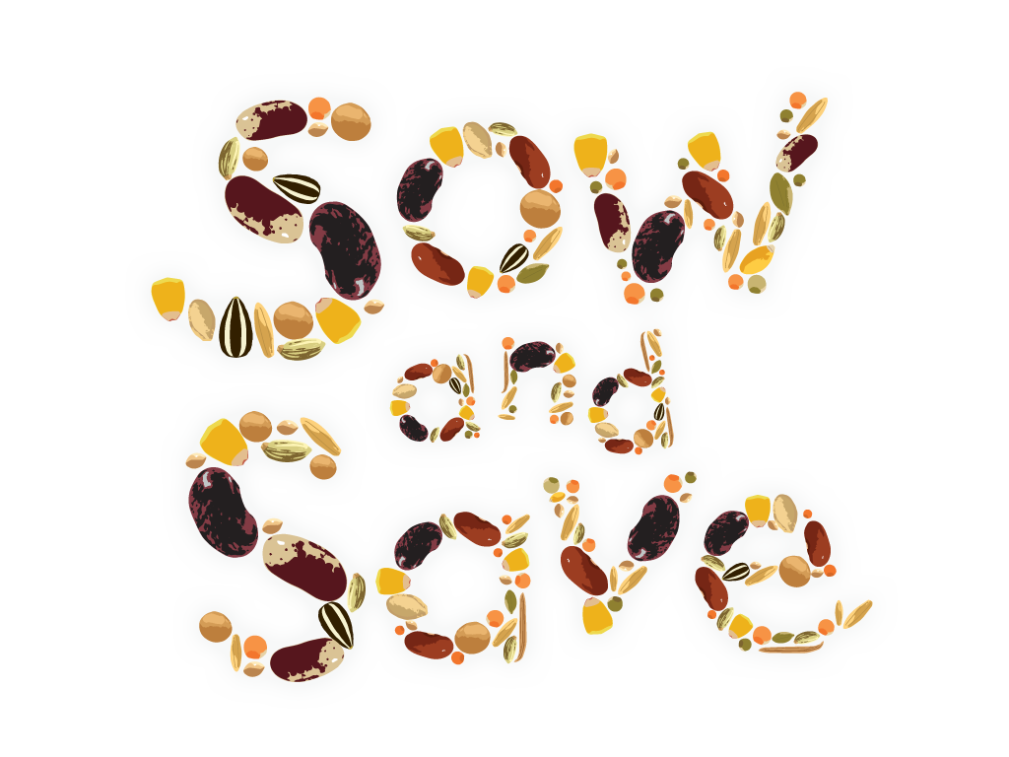

Slide 2
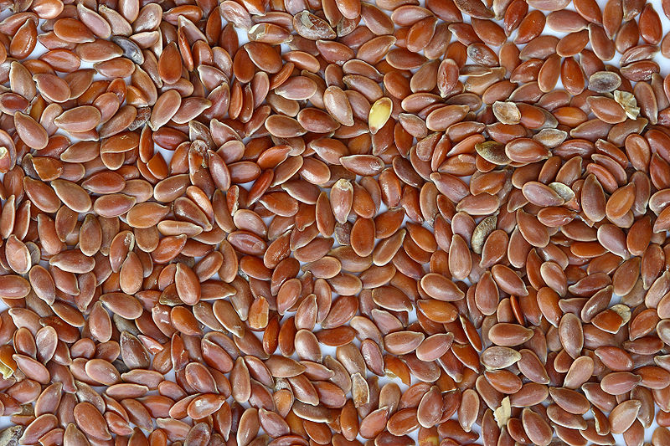
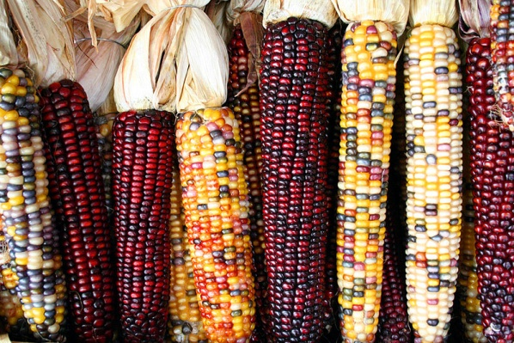
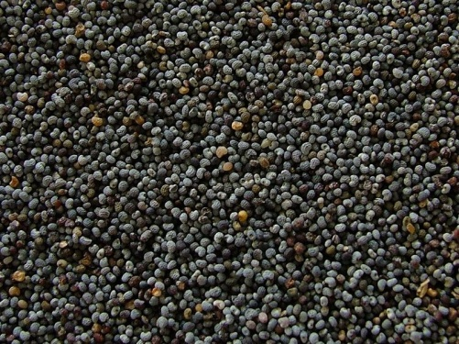
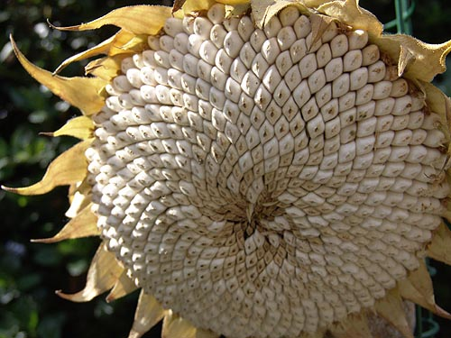
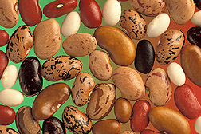
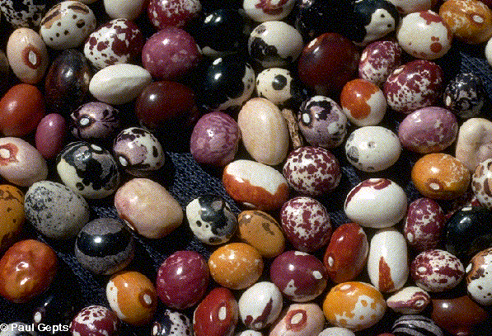
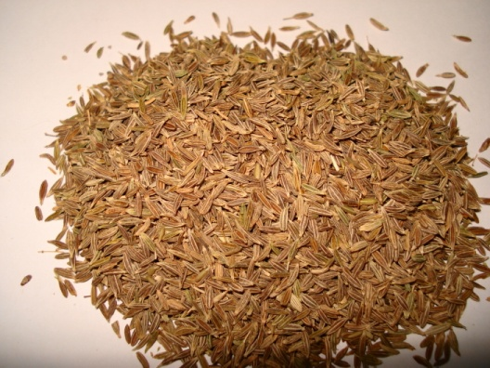
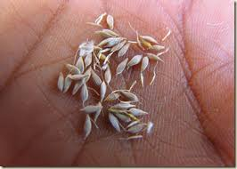
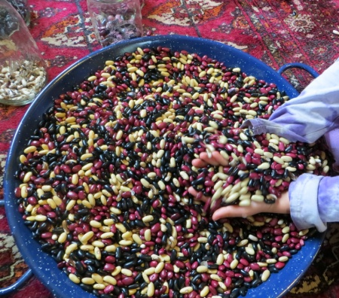
Seed Saving
and
Seed Banking

Slide 3
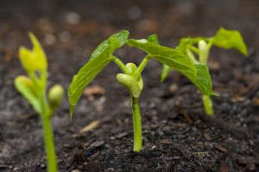
What is a Seed?
A seed is like a plant’s baby. Seeds are made by adult plants so that new plants can grow the following year.
Everything the seed needs to grow into an adult plant is stored inside an amazing little package waiting for the right time to unpack and start growing!

Slide 4
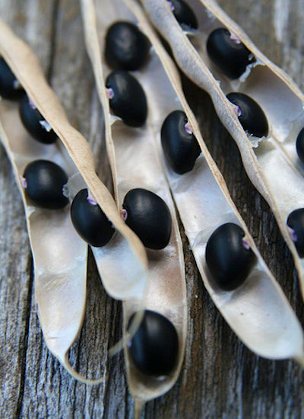
Are seeds alive?
Yes!
Seeds are alive but they are dormant. Being dormant is a bit like sleeping. Some seeds can only stay asleep for a few years and then they will die but some have stayed asleep for thousands of years.
Shhhhh!
Seeds sleeping!

Slide 5
How do you wake a sleeping seed?
You wake up a seed by letting it germinate. Most sleeping seeds can be woken up with water, air, warmth and light.
A seed is like a baby waiting to be born. Imagine if all your parents had to do was plant you loosely in the soil, water you and expose you to sunlight to make you grow!

Slide 6
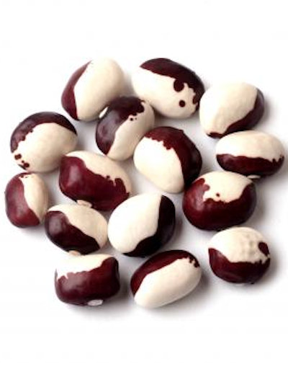
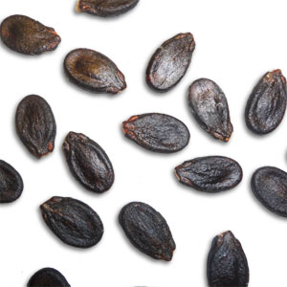
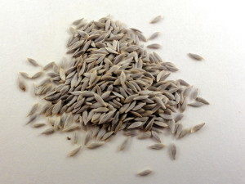
Why Should We Save Seeds?
Most seeds won’t stay alive for more than a few years so it’s important for us to keep planting, collecting and saving the seeds we need so that we always have a fresh, healthy seed supply ready for planting!
Life expectancy of some seeds:
Bean
3 years
Watermelon
4 years
Lettuce
6 years

Slide 7
Why else should we save seeds?
We save seeds......
To save seeds from plants that grow well in our own garden so that they will grow the healthiest possible plants in the future
To protect rare or endangered seed varieties that we love to grow but are hard to find
Save money by not having to buy new seeds every year
To have fun! Saving and collecting seeds lets us share different varieties with friends, classmates, families and other school gardens

Slide 8
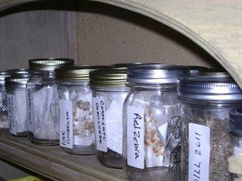
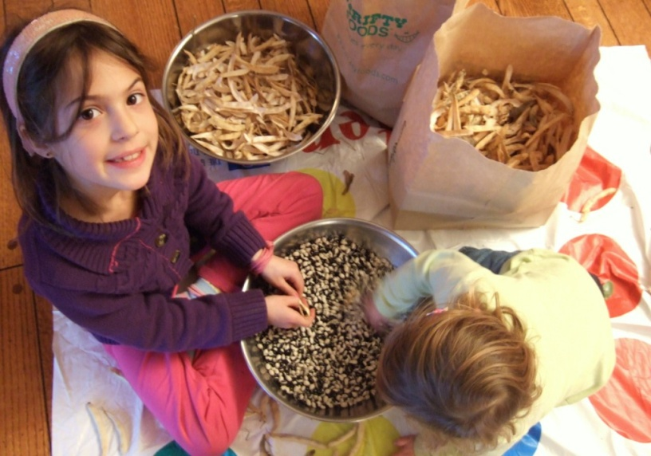
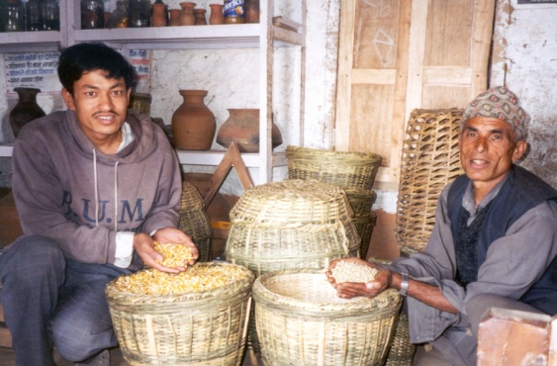
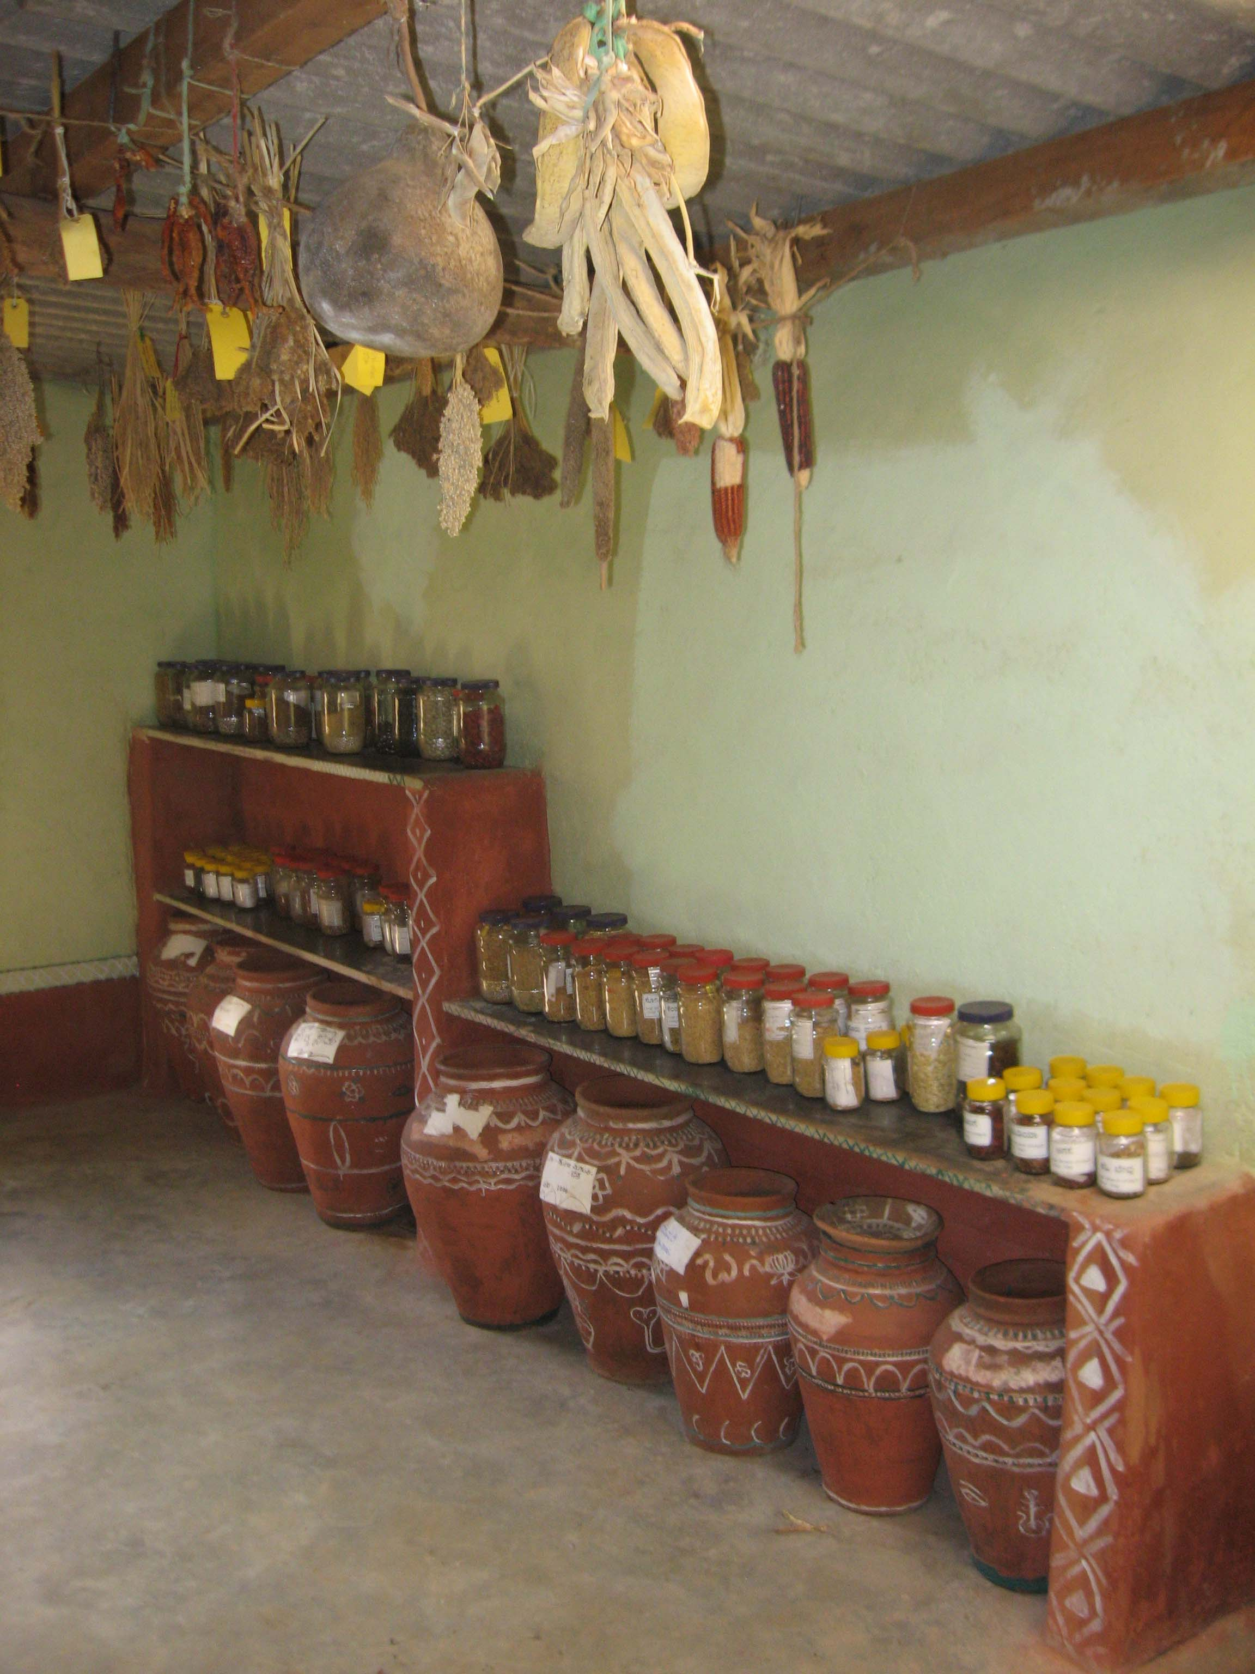
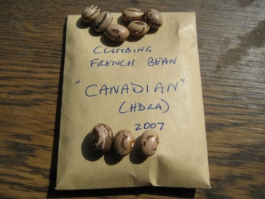
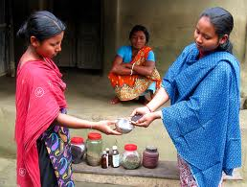
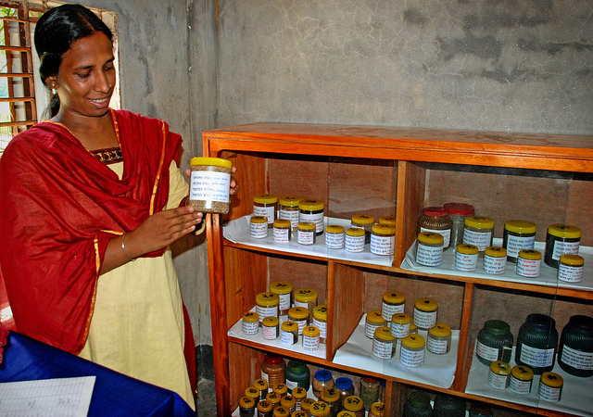
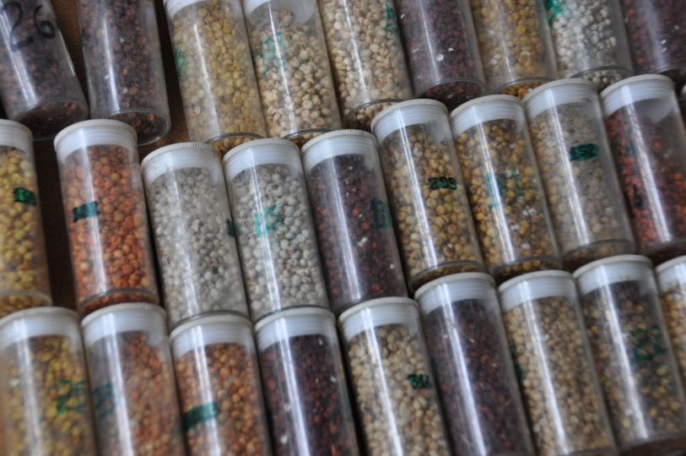
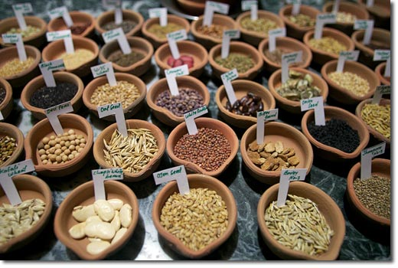
Where do people store their seeds?
Around the world people store their seeds in a variety of different places. Seeds can be stored in envelopes, glass jars, pots, bags, baskets, drawers, you name it! To be saved properly though seeds must be kept cool, dry and dark.

Slide 9
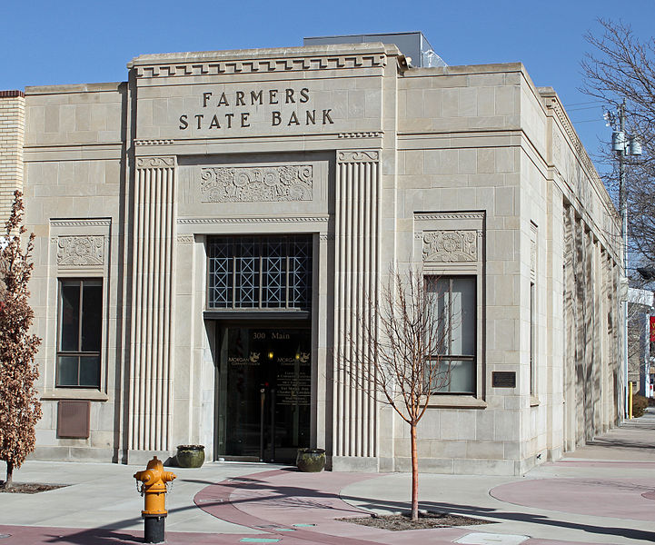
What is a Seed Bank?
Banks are not just for money! People put their money in banks to keep it safe. People also keep seeds in seed banks to keep them safe!

Slide 10
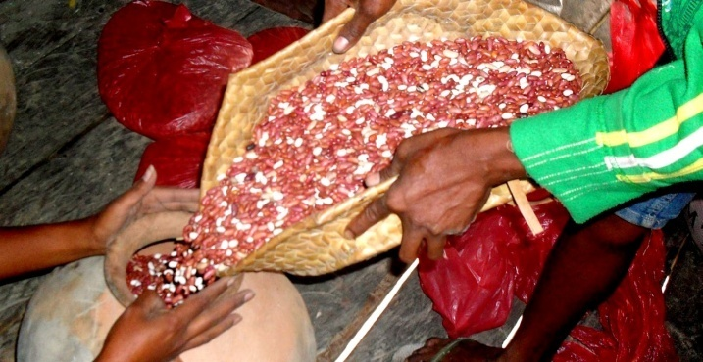
What Do Seed Banks Look Like?
Seed Banks come in all shapes and sizes. They may hold a handful of seeds or a few million seeds. Some are large international seed banks, some are community seed banks, and others are kept by everyday people like you!
Anyone can build a seed bank. Let’s visit a few seed banks around the world…..

Slide 11
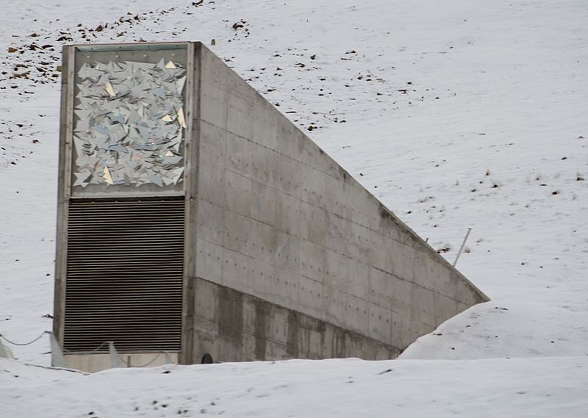
The Svalbard Global Seed Vault
This is the world’s largest seed bank holding millions of seed samples from around the world. This seed bank is carved into a mountain in the Norwegian High Arctic. Seeds are kept dry, dark and cool inside the mountain.

Slide 12
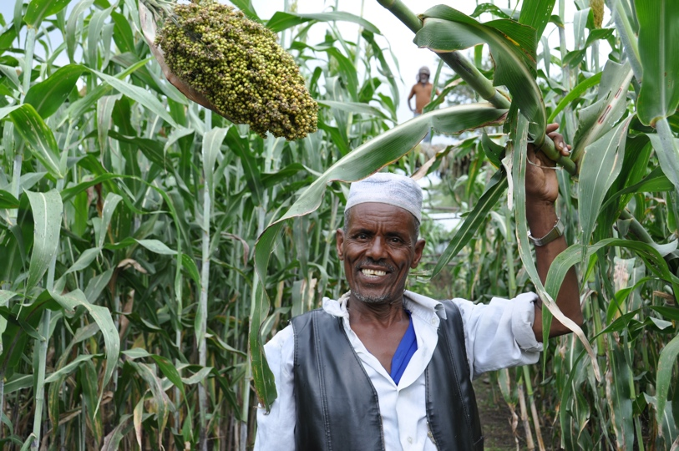
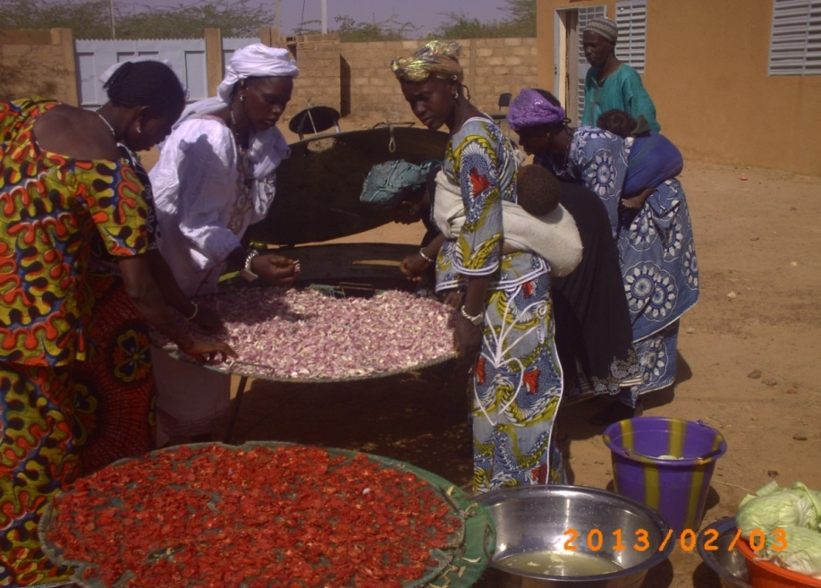
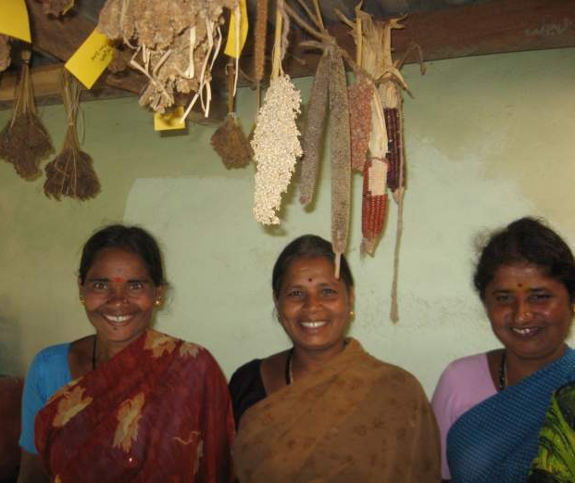
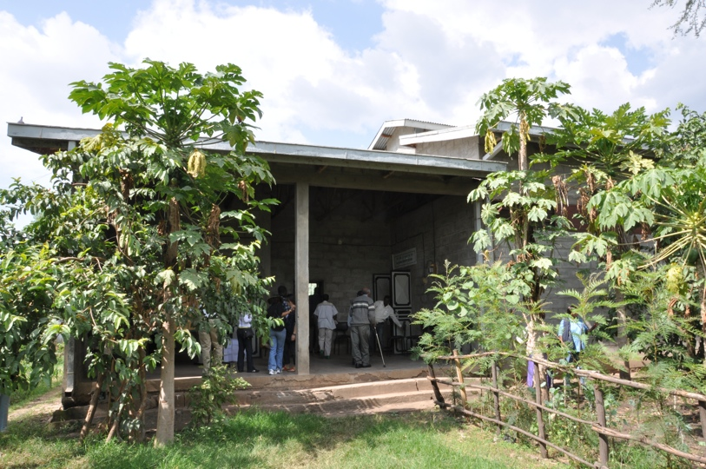
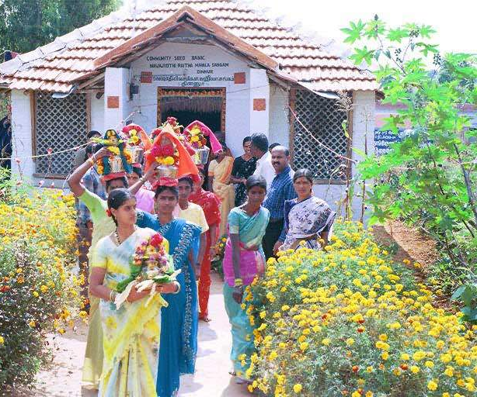
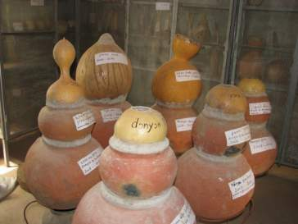
Community Seed Banks around the World
Seed banks help farmers save, store and share their seeds
Ethiopia
West Africa
India

Slide 13
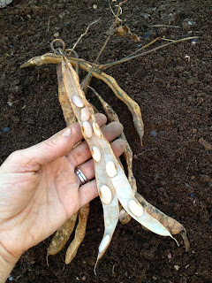
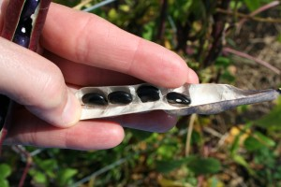
How Can We Save our own Seeds?
Most seeds are easy and fun to save!
To collect seeds, wait until the plant turns brown and dry in the late summer or early fall, then collect the seeds by picking, rubbing or shaking them off.
Once the seeds are removed from the plant they need to be kept under the three magic conditions:
Dry Dark Cool
Here are some examples of seeds to save…..

Slide 14
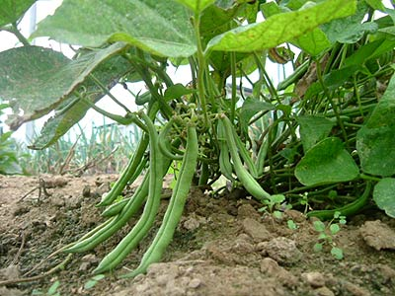
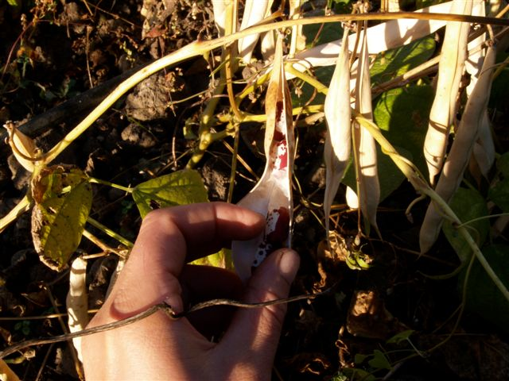
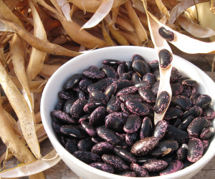
Collecting Bean Seeds
Bean plant
In the fall the bean pods will turn brown and dry
Pick the bean seeds out of the dry pods
and save them for planting next year to make new bean plants!

Slide 15
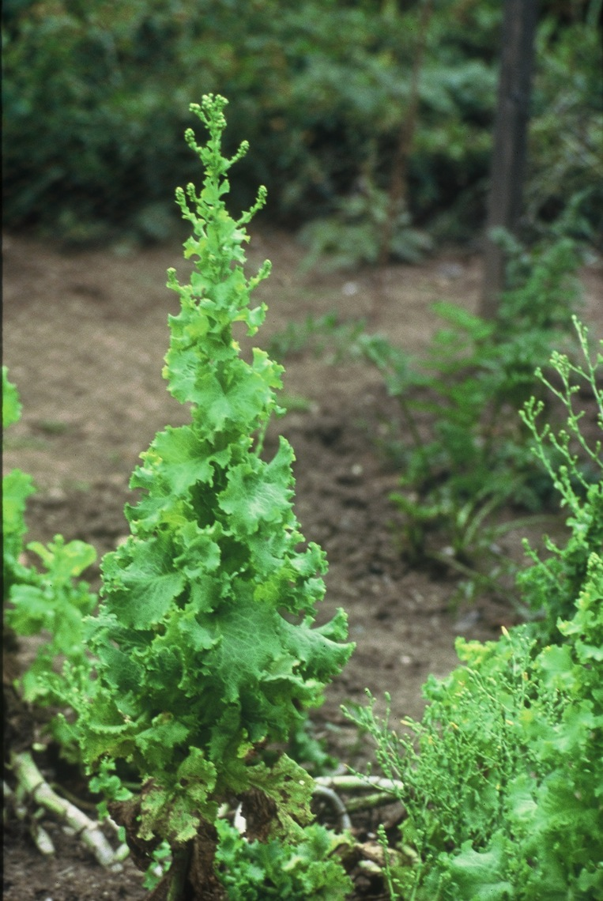
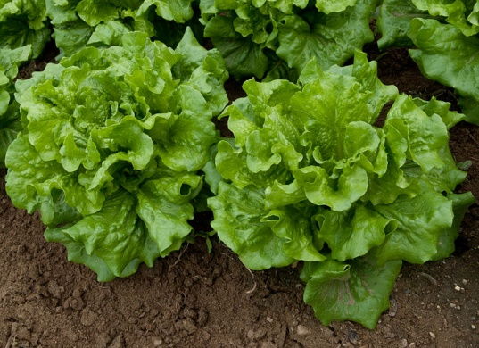
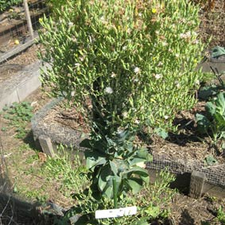
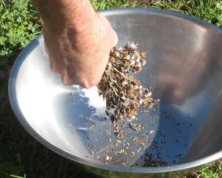
Collecting Lettuce Seeds
Lettuce
The small flowers at the end of the spike will eventually turn into seeds.
In the fall lettuce will send up a tall flower spike.
Shake the seeds out !
Collect the seeds and save them for planting next year to make new lettuce plants!

Slide 16
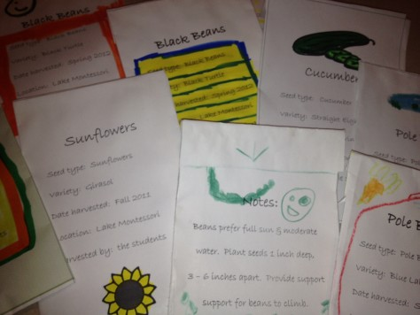
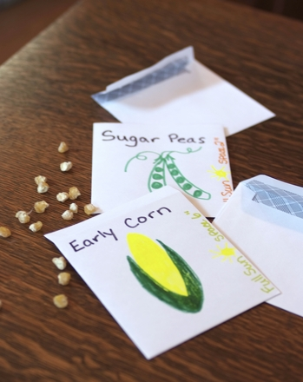
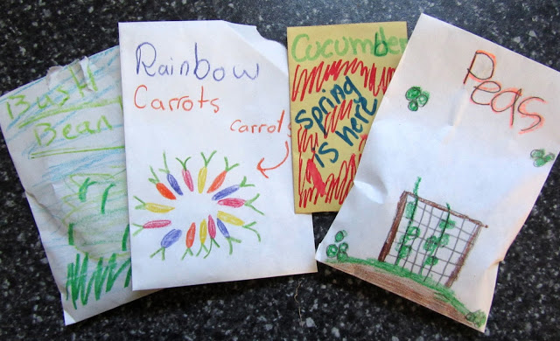
Label Your Seeds
Why? You don’t want to forget what is in each seed pack! If you share them with other people they will want to know what is inside! Include the following information:
The name of the species and variety (Dragon Tongue bean)
The year the seed was collected
The location where the seed was collected (our school garden)

Slide 17
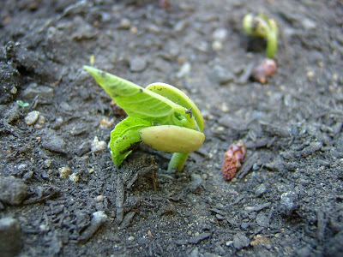
Congratulations! You are a seed saver!
Now store your seeds in your class seed bank and dream of next year’s spring planting....

Slide 18
Happy Seed Saving!

